Slide 1


Cloud Computing Project
WealthWave
https://wealthwavenyu.net/
-Siri Chandana Errabelli (se2596)
-Vamshi naik Vislavath (vv2289)
-Sai Aravind Yanamadala (sy3902)
-Tanmay Rathi (tr2452 )

Slide 2

Problem Statement
Personal finance management faces a critical challenge not just in tracking expenses but in effectively categorizing them for insightful analysis.
- Inadequate Expense Tracking: Traditional tools are often manual and prone to errors
and lack sophisticated categorization which leads to minimal spending insights.
- Financial Planning Obstacles: Ineffective categorization hinders sound financial planning and budgeting. Existing solutions fail to offer automated, intelligent categorization.
WealthWave provides an advanced, automated solution for tracking and intelligent categorization of expenses.

Slide 3
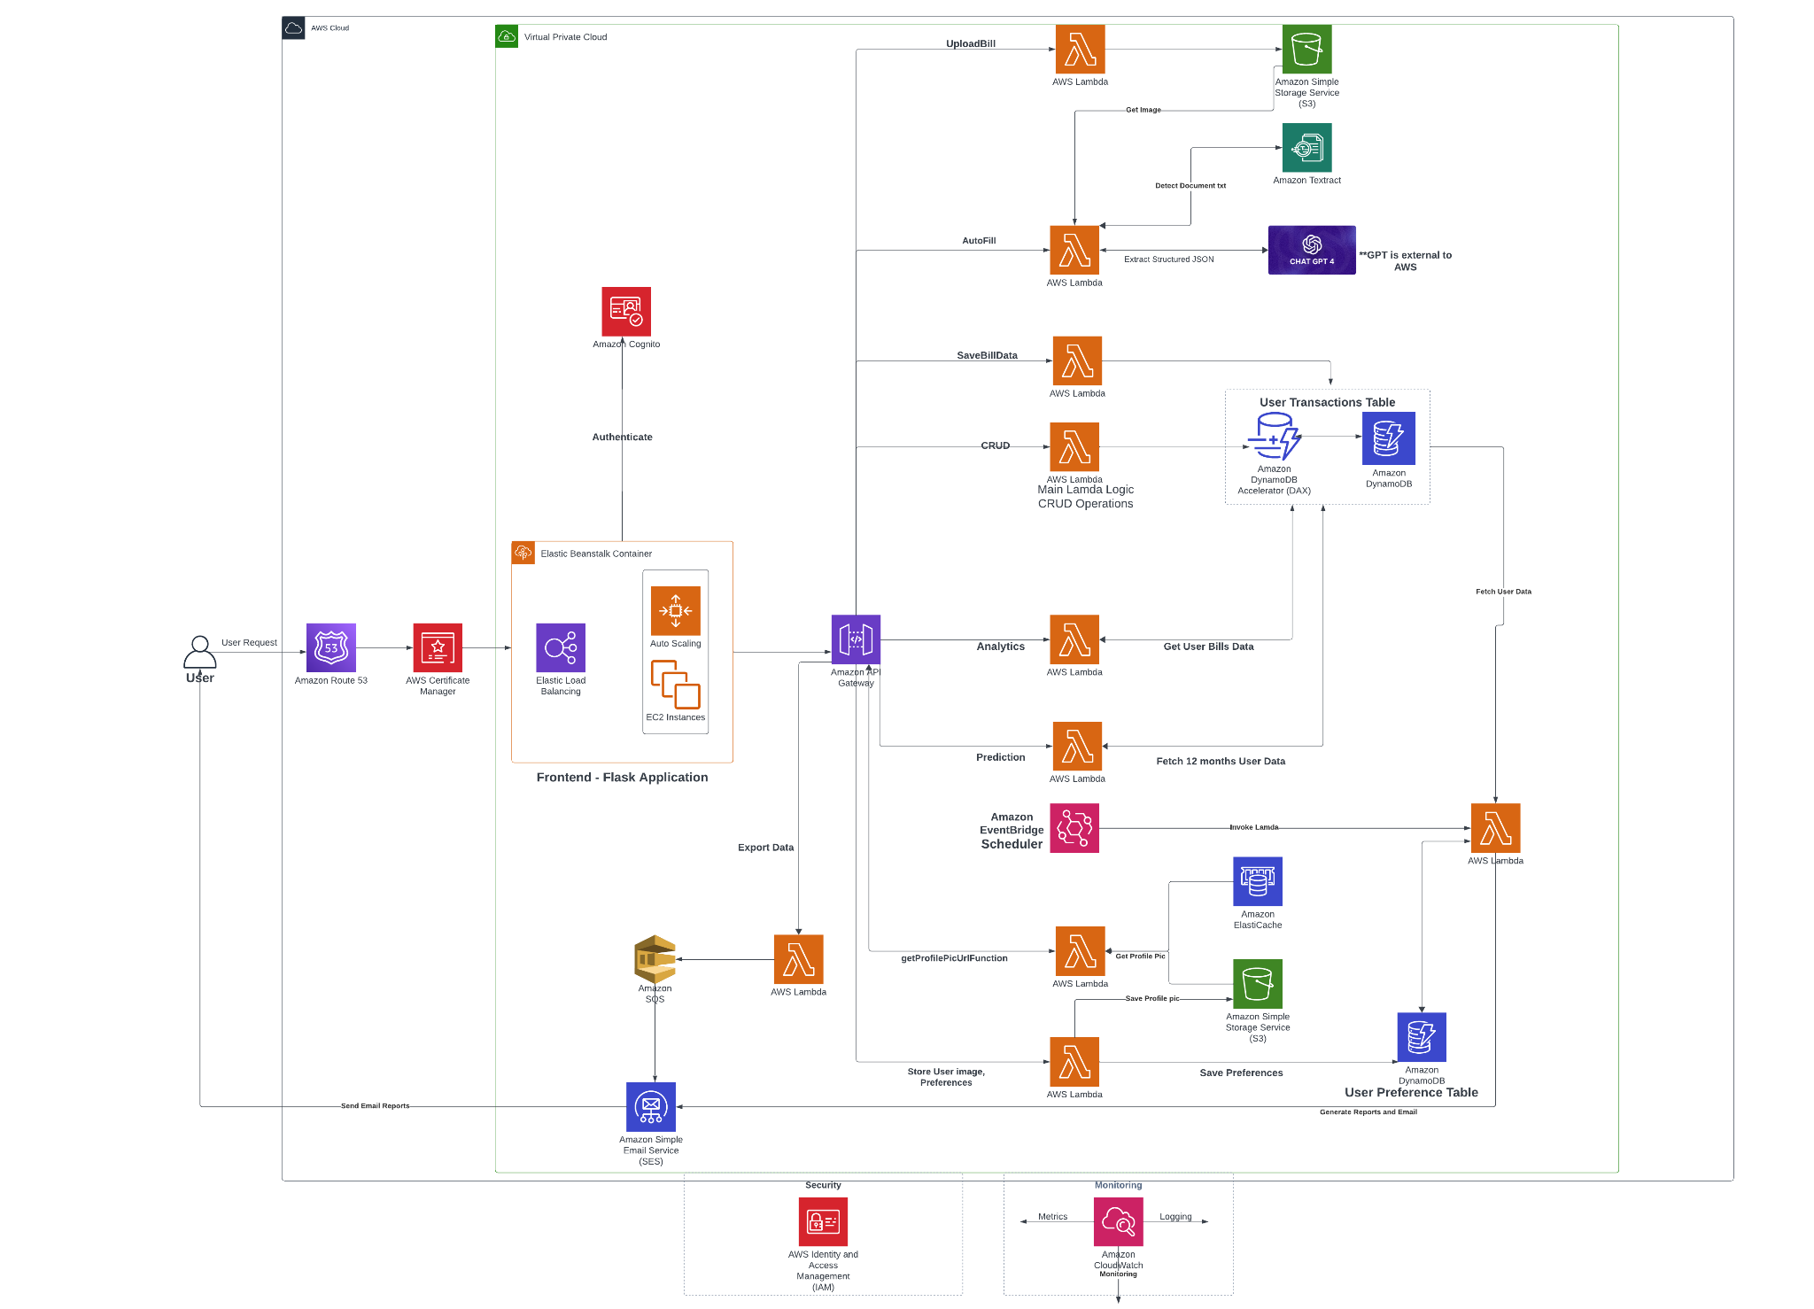
Application Architecture

Slide 4
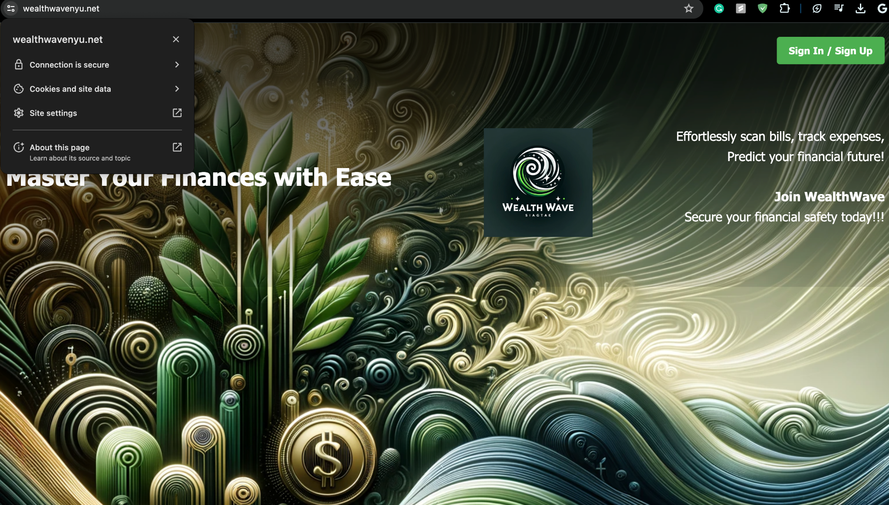
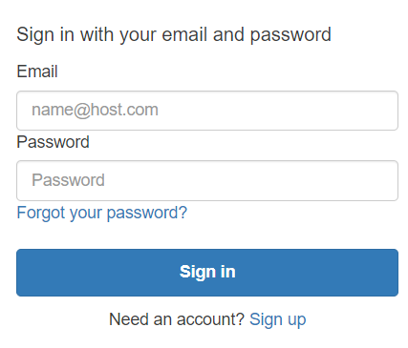
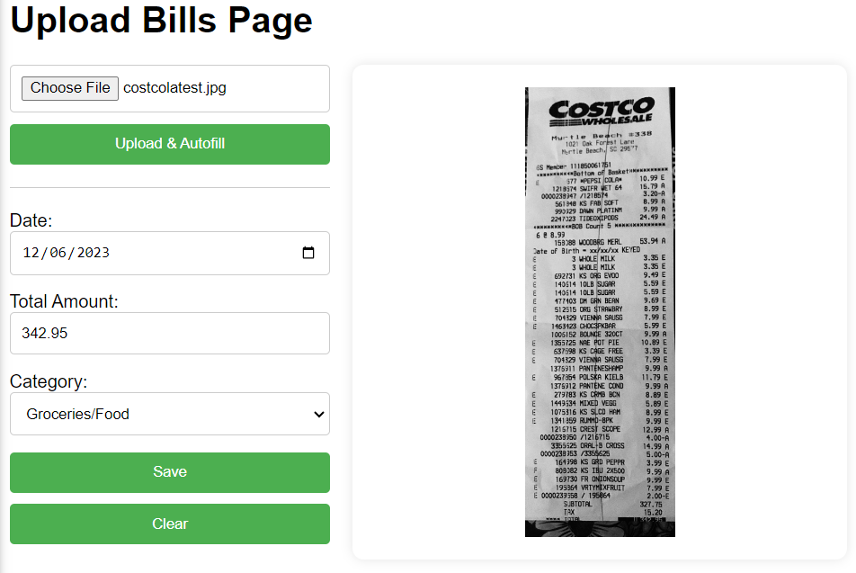
Components and Workflow
Frontend Application: Utilizes Flask, hosted on AWS Elastic Beanstalk with Elastic Load Balancing and Auto Scaling for scalability.
Authentication: Incorporates Amazon Cognito for secure user signup/login and session management.
Routing: Domain management and request routing through Amazon Route 53 to the application server.
User Interaction Workflow:
Users easily upload bill images via the application interface.
Amazon Textract extracts text from the image stored in S3 Bucket.
Extracted text is given to ChatGPT via API, which returns financial data like date, total amount and category as the response in JSON format.
Users can verify and correct financial data extracted.
Upon confirmation, data is saved in DynamoDB table.

Slide 5
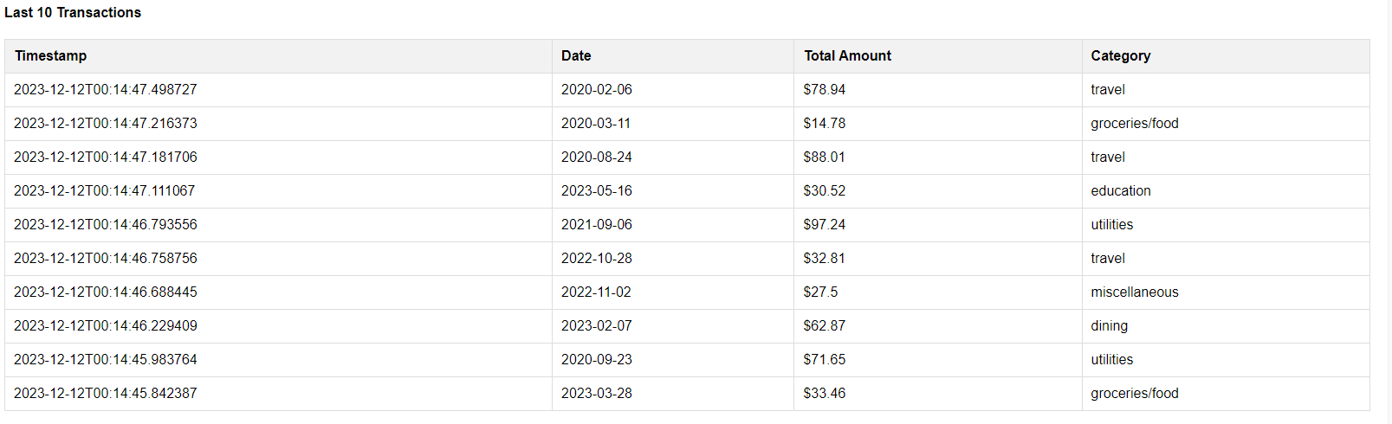
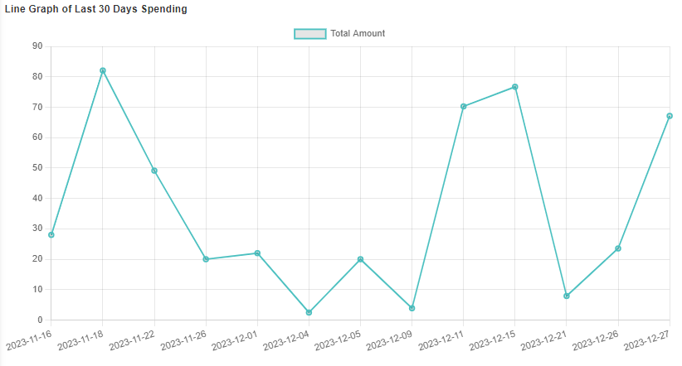
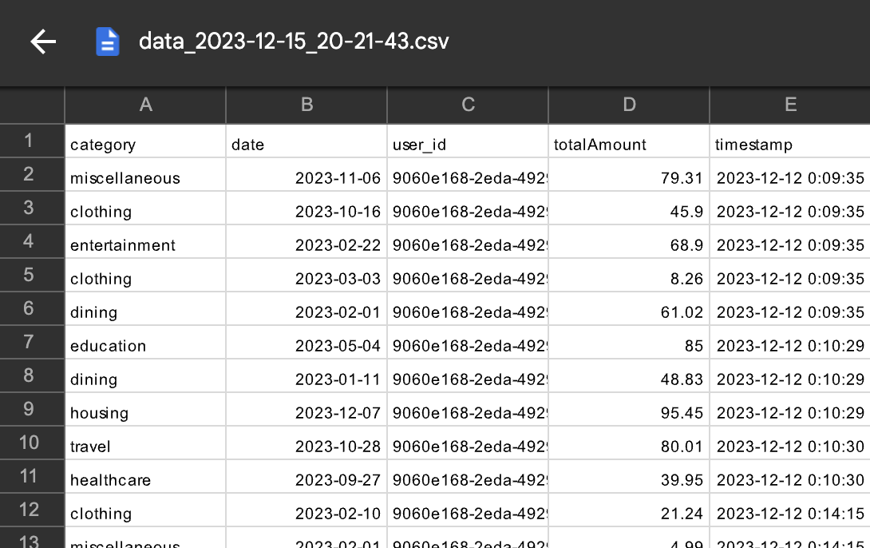
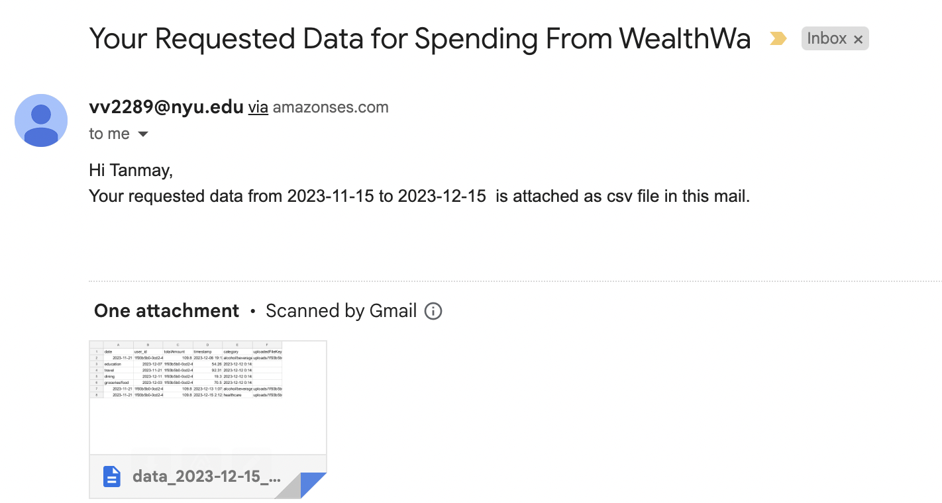
Components and Workflow
Data Management:
Home page displays user transactions.
Uses DynamoDB to store structured bill data.
User transactions are managed through CRUD operations with Lambda functions.
Analytics:
“Analytics” page shows reports and pie charts based on user uploads.
Lambda functions analyze bills and transaction data.
User Reports:
Options for reports like last week, last month, or custom dates.
Automated email reports via Lambda and Amazon SES upon request completion.

Slide 6
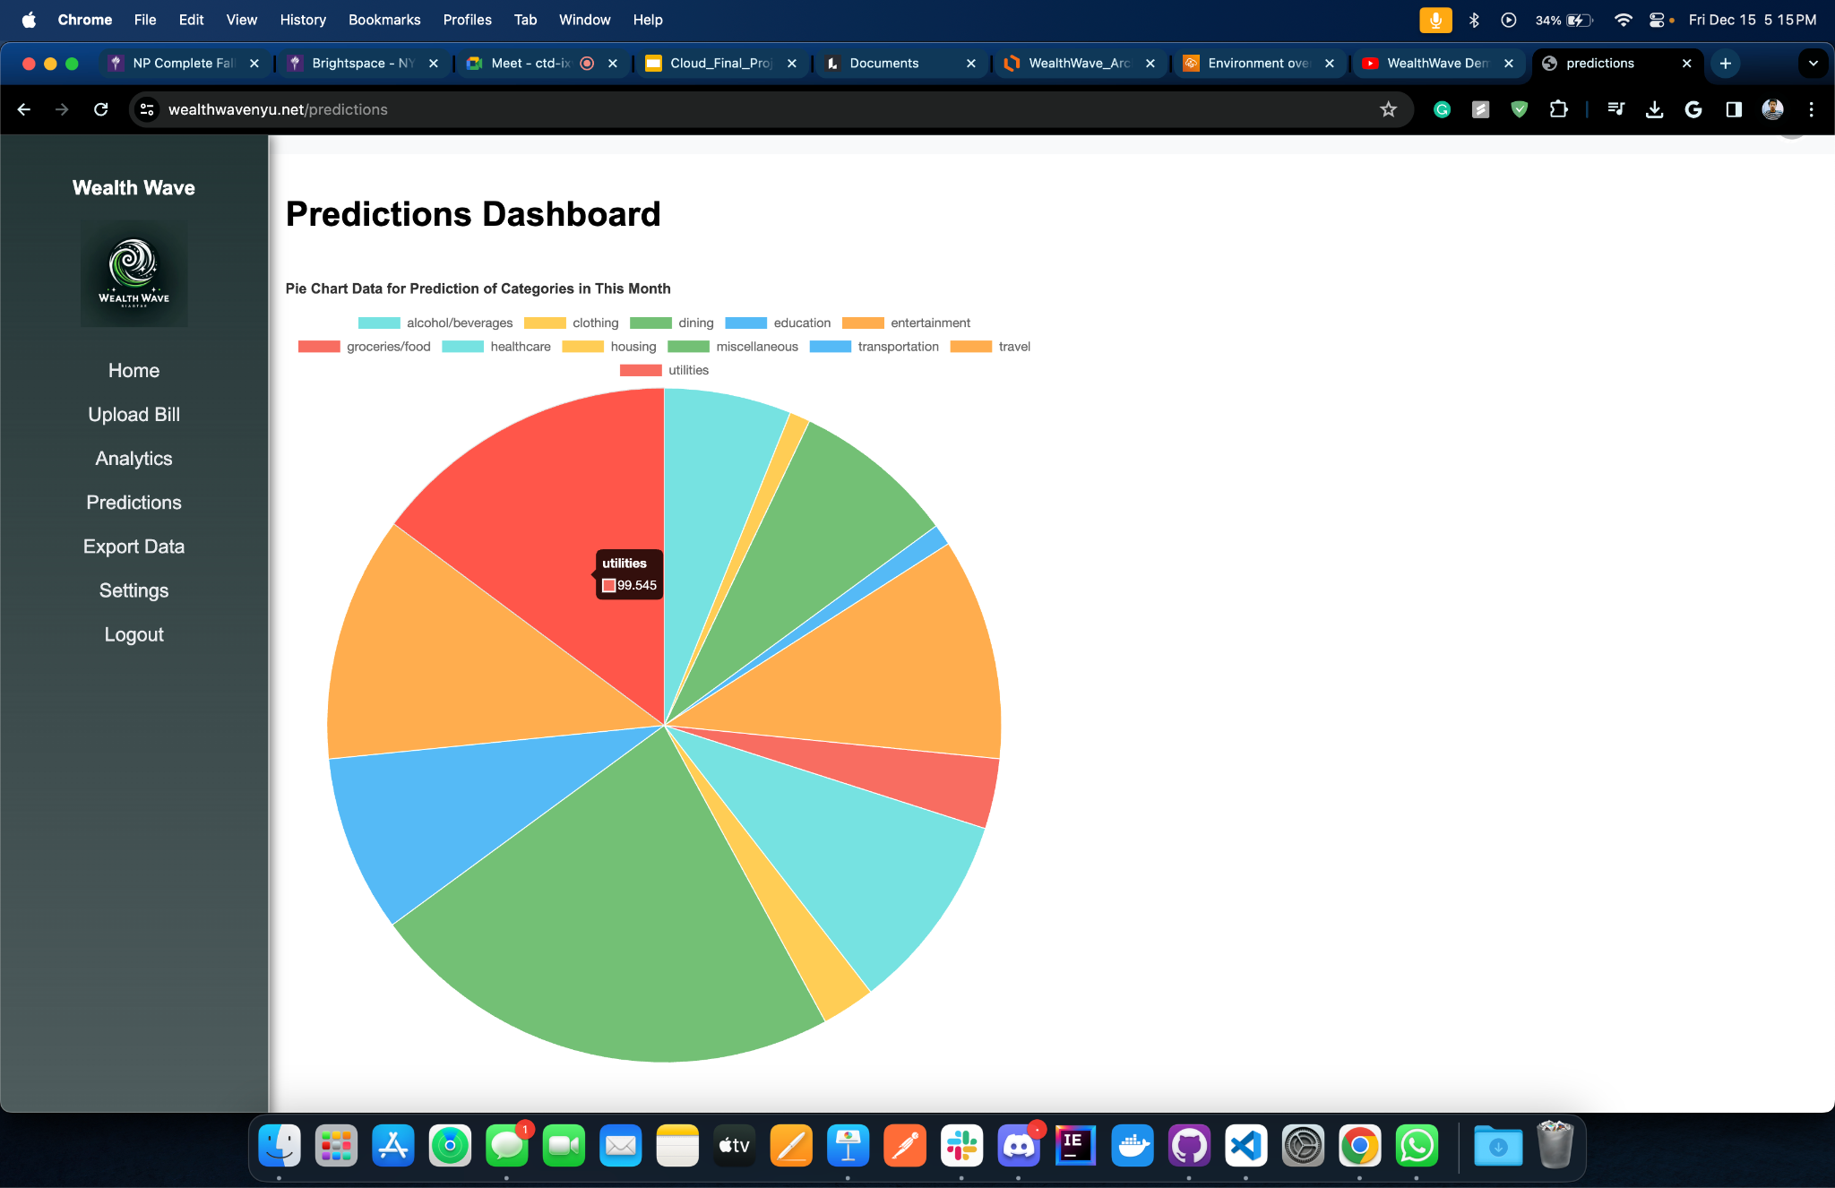
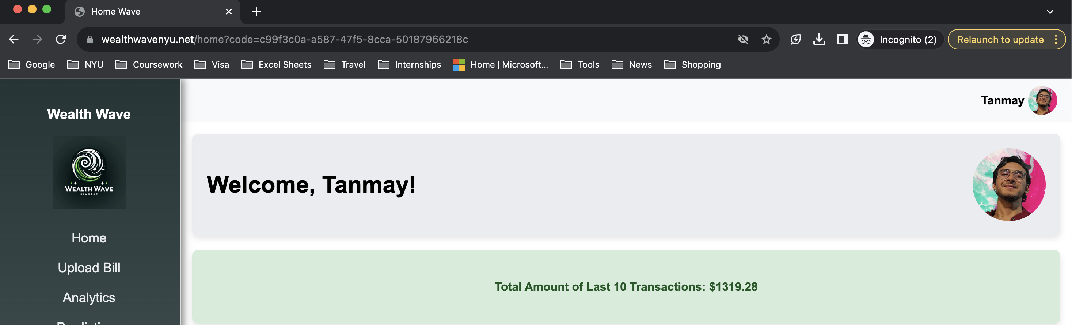
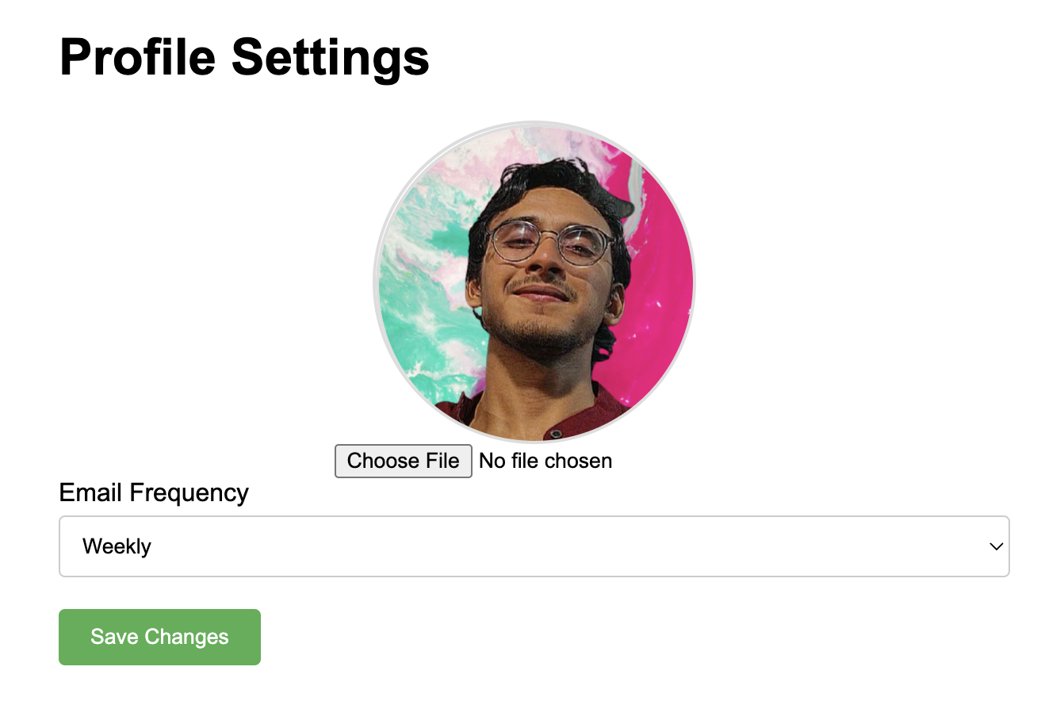
Components and Workflow
Prediction and Insights:
Predictive visualizations for the current month's expenses on the "Predictions" page.
Pie chart predictions by category, utilizing Lambda and ML models for data forecasting.
Settings Page:
Profile personalization with image upload to Amazon S3.
User-preference management for report frequency, stored in a dedicated database table.

Slide 7
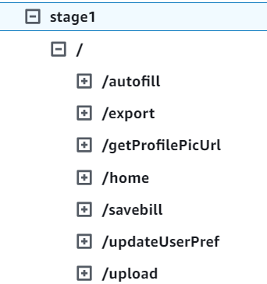
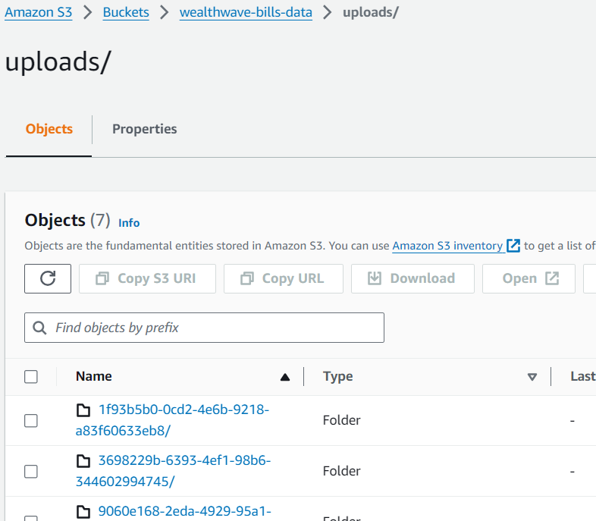
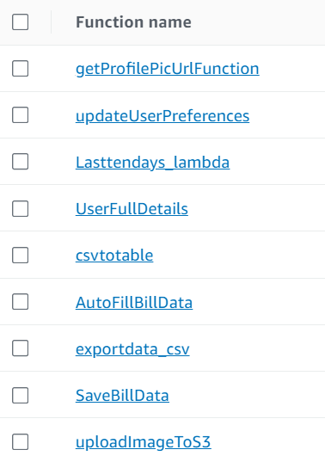
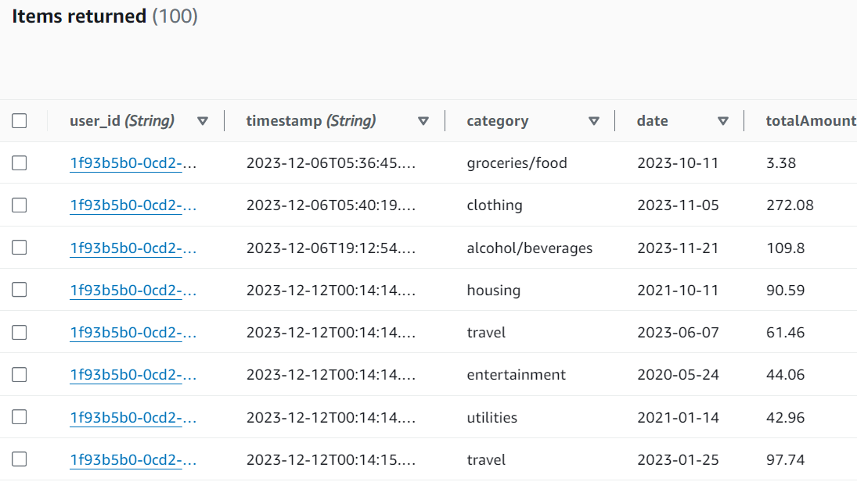
WealthWave - Components
API Gateway : S3:
Lambda Functions : Dynamodb:

